Slide 1
Smart Watch Progress Report 11/11
Derek Tan, Julian Nguyen, Eddie Ryan

Slide 2
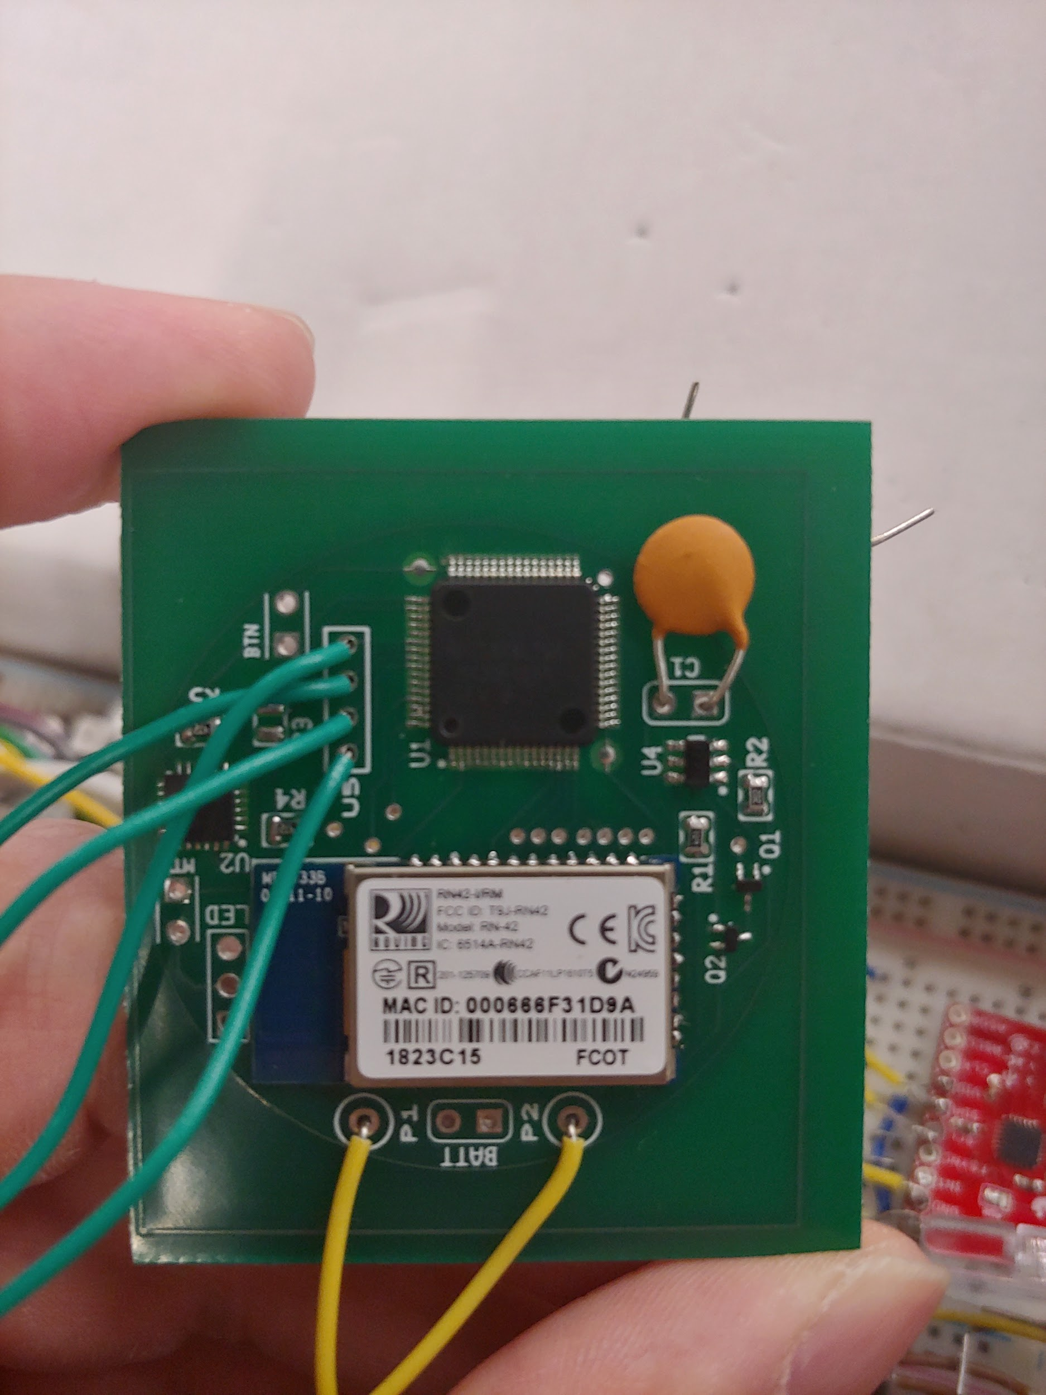
3W Mounting and JTAG Testing

Slide 3
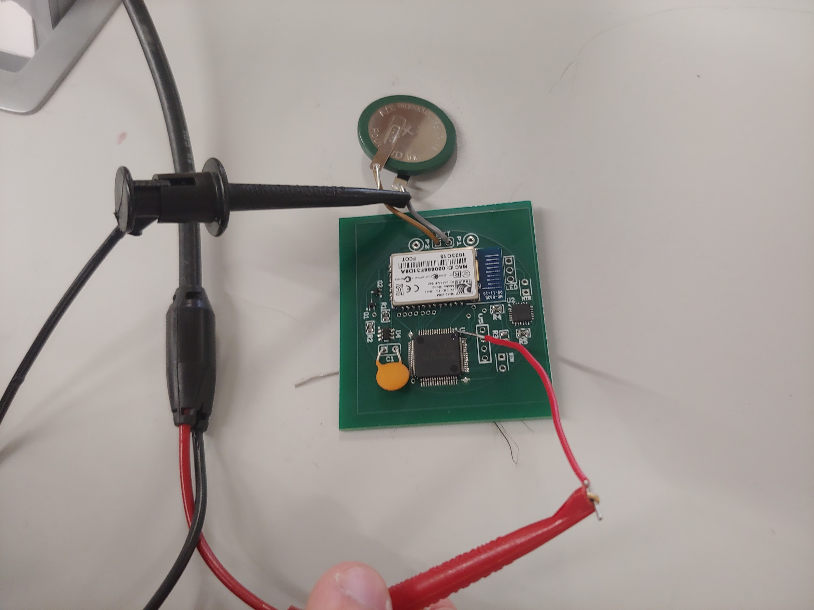
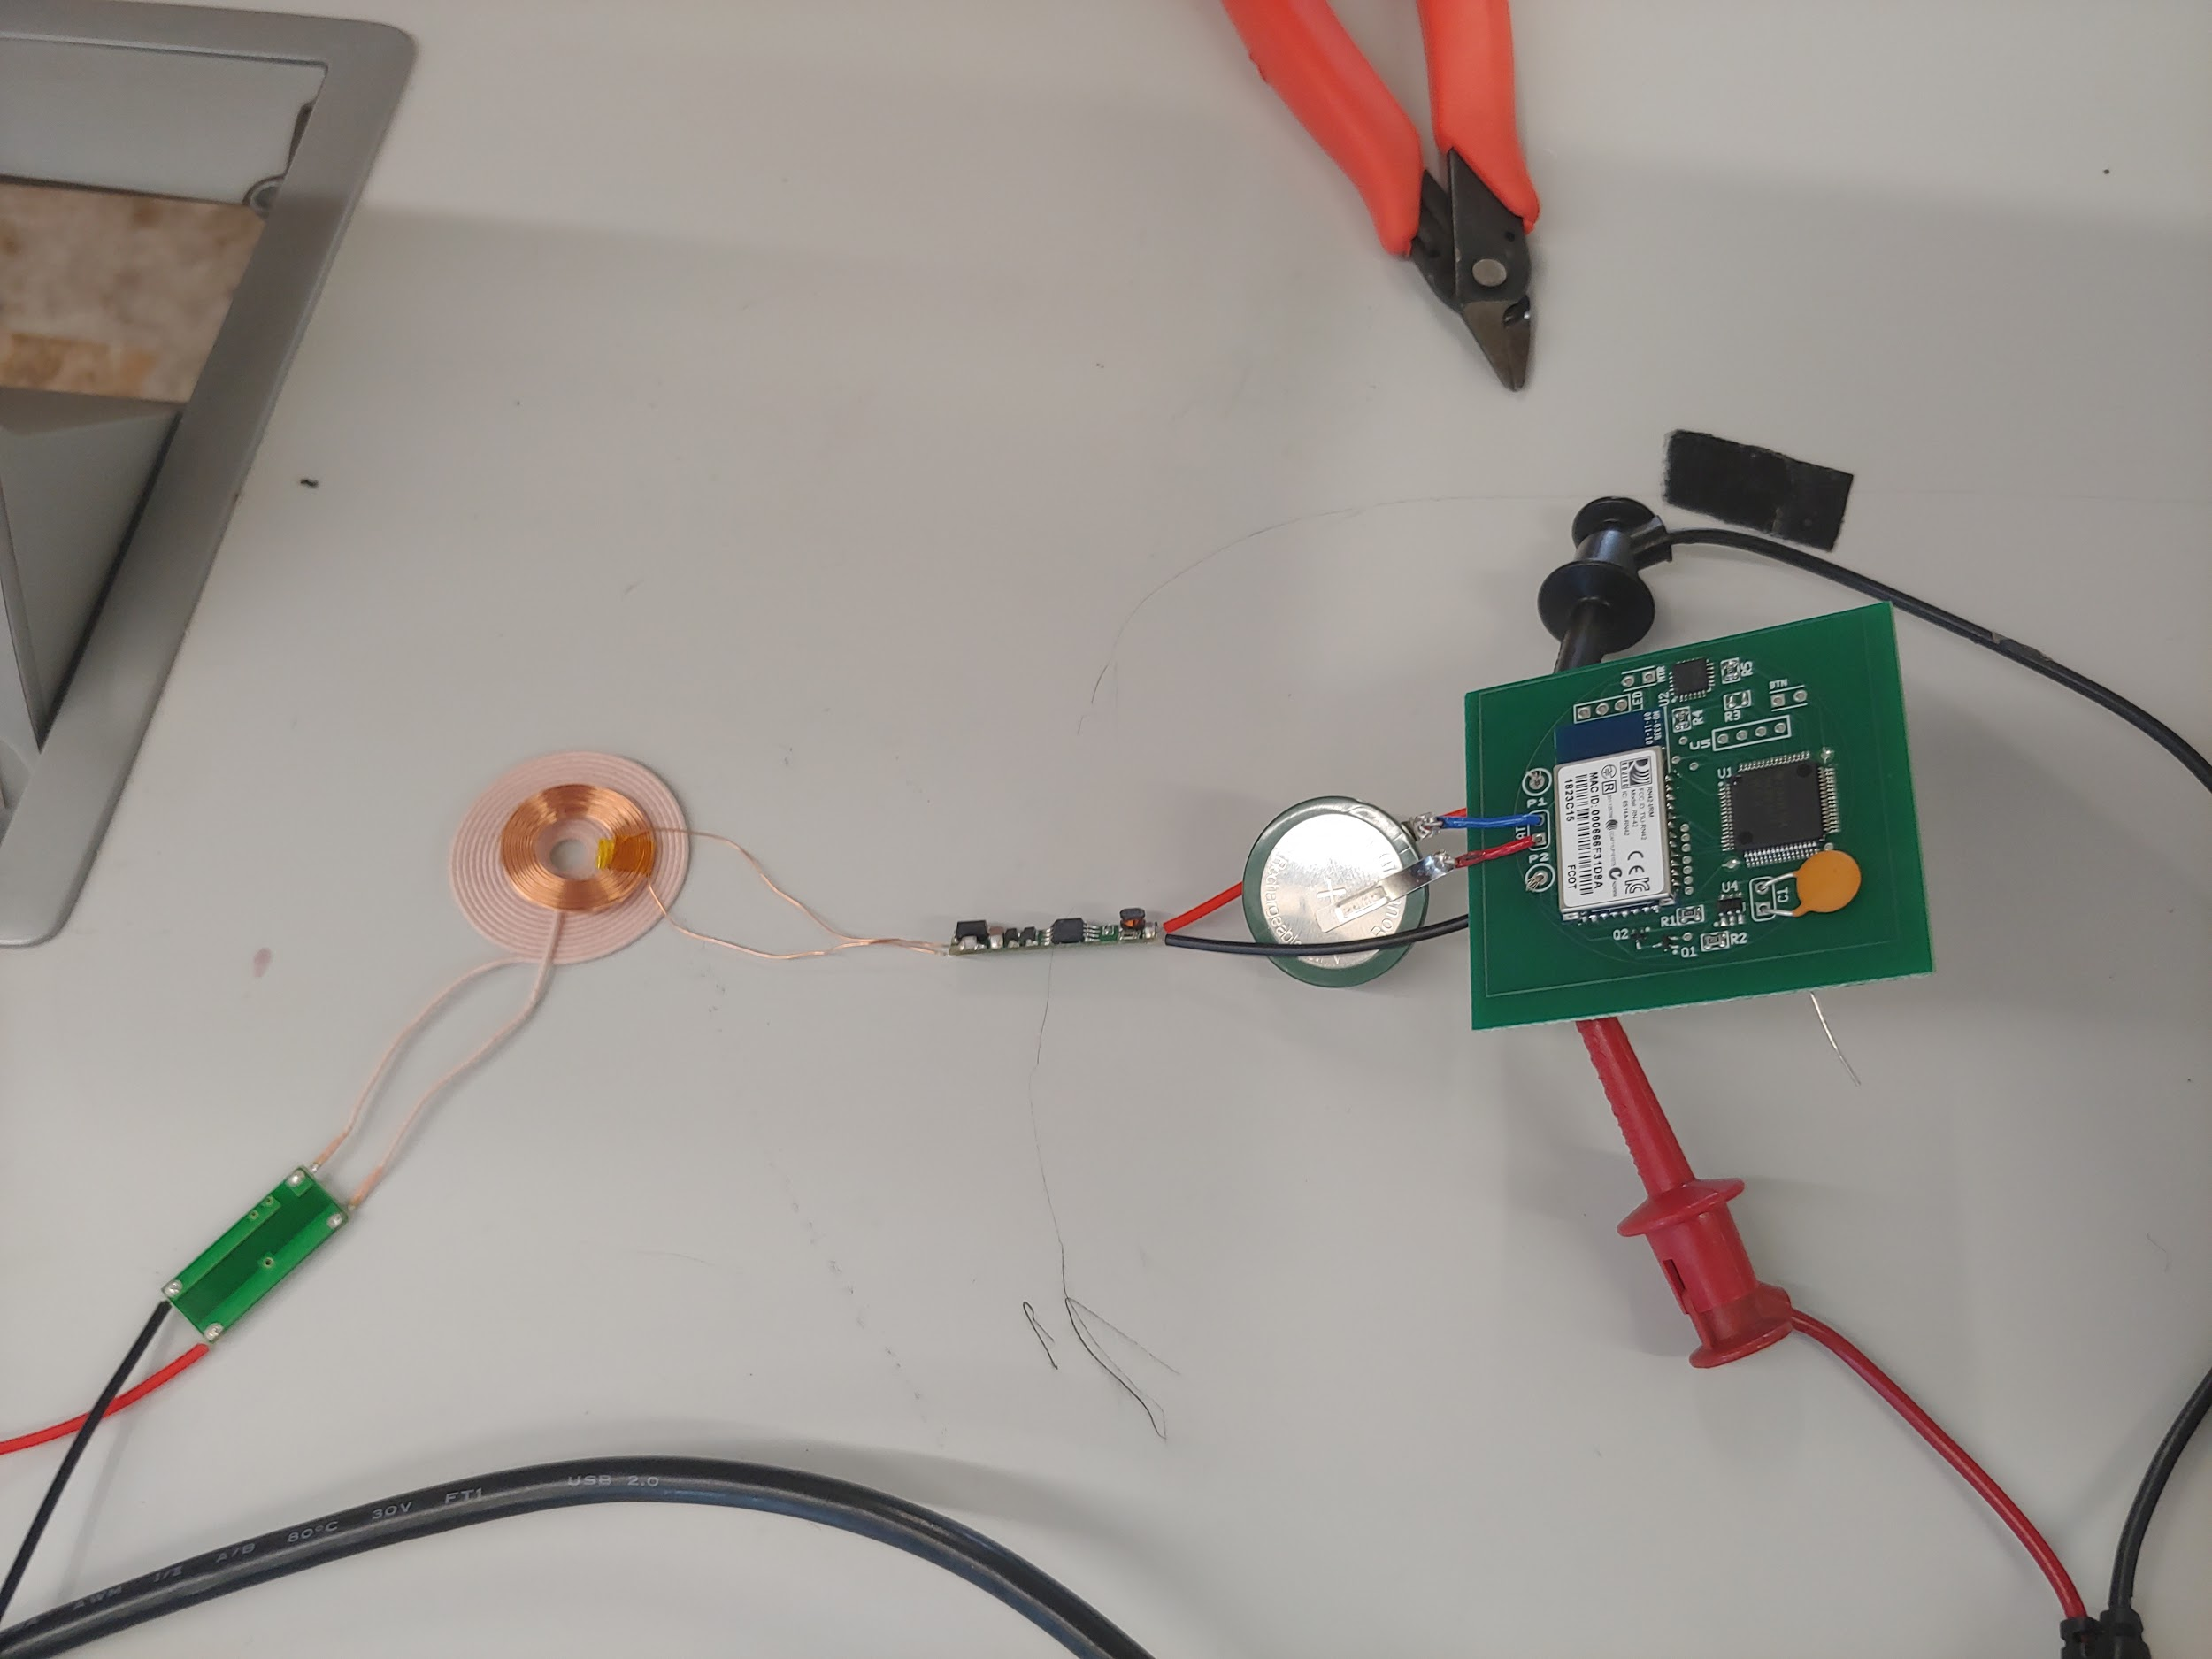
Testing Power Module And Charging

Slide 4
PCB Changes
Add bypass capacitors
Add reset interface for MSP430
Made board slightly bigger to incorporate above changes

